Slide 1
NCW Town FC
Parents Presentation 2019
Kieran Shanahan
Academy Manager

Slide 2
Questions?
What should NCW Town’s objective be?
What impact am I having?
What do I get out of it?
Why am I here?

Slide 3
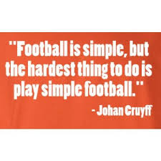
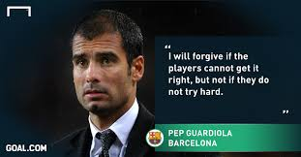
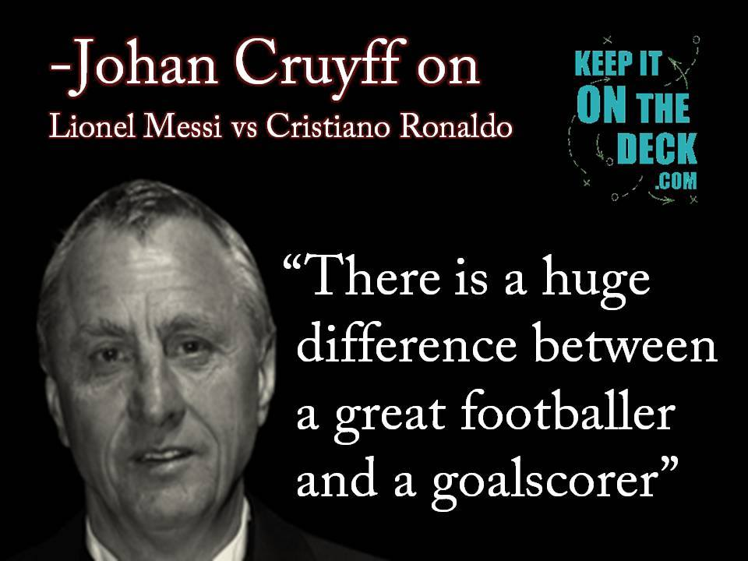

Slide 4
Expectations?
What do you expect from a player on the pitch?
What should they be capable of?
What do you want from your players off the pitch?
What’s the most important thing to you?

Slide 5
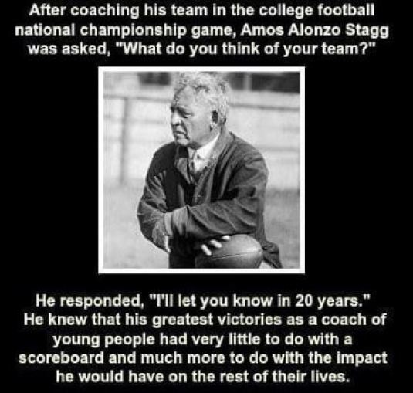

Slide 6
Membership Fee
Registration Fee:
First Child €60, Second Child €40, Third Child €20
Registration takes place on Tuesday 12th February and Friday 15th February.
Training Fee’s:
Option 1: One off payment of €60
Option 2: €10 per month for 8 months coming to a total of €80. (Direct Debit may be an option; the club are currently looking into this)
These fee’s will cover your child for however many training sessions he or she does, so for instance if a child does a session on Tuesday in the AstroTurf and then a pitch session on a Thursday you still only pay your €60 one off or €10 per month. The only exception would be Futsal which has to be paid nightly.

Slide 7
The training fees are what the club uses to take care of the mortgage on the AstroTurf and maintenance of the pitches in the Desmene and Woodfield.
In the calendar year we anticipate approximately 9 months of football, assuming 1 session per week at a minimum we can assume that a child will have 36 football sessions in a season.
The old method of payment was €3 per session which would come have to €96, or if you had numerous children and paid €2.50 per session it would have come to €90.
Comparable Clubs:
(Based on facilities, population etc.)
Regional Utd: €100 per child, max €150
Killarney Celtic: €60 per child, max €120, Killarney Athletic: €60 per child, max €120
Midleton Utd: €200 per child, includes buses, max €300 per family
Monaleen GAA: €90 per child, Na Piarsaigh GAA: €60 per child, max €200
Singing Lesson: €18 per lesson (30 Minutes)

Slide 8
Coaching Pathway:
Our coaches are Garda Vetted and have attended the relevant child welfare courses.
The coaching courses and their costs are explained briefly as follows:
PDP1 6-9 Year olds: €45, PDP 2 9-12 Year olds: €75, PDP 3 Youth 13-18 Year olds: €120, Adult Into €120.
4 v 4, 7 v 7, S&C Courses, Futsal Intro: €25 each.
Fundamentals of Goalkeeping: €45
Goalkeeping D Licence: €90
National D Licence: €90
National C Licence: €600
Goalkeeping C Licence: €210
CLUB COVER THE COST OF ALL OF THE ABOVE
UEFA B Licence: €3000
UEFA A Licence: €4000
UEFA Pro Licence: €8000
We estimate spending anywhere from €2,000 - €3,000 per year on coach education courses
Over €1000 already spent in 2019

Slide 9
Player Pathway:
Club:
100% of players in Ireland play at club level and should be able to play every sport they want to play.
Desmond League Academy U11, U12, U13, U14 (Kennedy Cup) U15, U16, Youths, (Oscar Traynor Trophy):
5% of players in Ireland will be deemed of the required standard to play at this level. These children remain able to play all the other sports that the want to play, normally however football begins to take precedent over other sports in terms of contact hours.

Slide 10
Emerging Talent Programme U12, U13 and U14:
1% of players in Ireland at a given age are selected to become a part of the ETP Programme, approximately 200 players in the county would be part of the ETP Programme, approximately 50 Dublin based players and outside of Dublin there are 10 Regional ETP Centres containing approximately 15 players in each.
By this stage these players will begin to take football much more seriously and begin to specialize in the sport.
Most if not all these players would be of a minimum of League of Ireland level and will hopefully go on to play in the U13, U15, U17, U19 and Senior League of Ireland.
International Centre of Excellence U13 and U14:
0.2% of players in Ireland will take part in the COE, these players are selected from their Regional ETP Programme.
This would contain the best 30 players in Ireland in an age group, these players will make up the pool from which the International teams are picked, although not exclusively.
U15, U17, U18, U19 International:
0.1% of players, the best 20 players in the country.

Slide 11
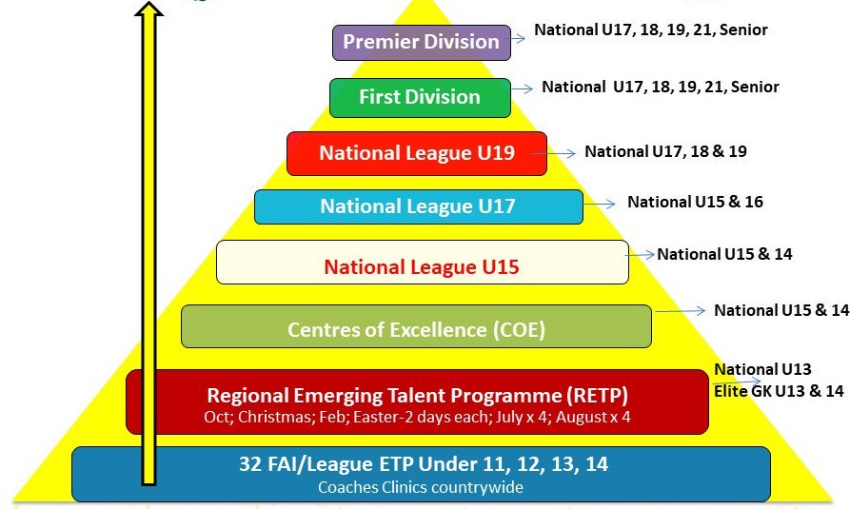
Elite Player Pathway:

Slide 12
Calendar Season Football:
U6, U7, U8, U9, U10 will remain on Saturdays as before.
Competitive Matchdays
Boys:
U11 ? (Tuesday)
U12 Saturday
U13 Monday
U14 Saturday
U15 Tuesday
U16 Thursday
Girls:
U12 Saturday
U13 ?
U14 Saturday
U15 ?
U16 Thursday

Slide 13
Provisional Fixture Dates:
U12 Boys
Sat 9/3 L
Sat 30/3 L
Tue 9/4 L
Tue 16/4 L
Tue 23/4 C*
Wed 24/4 L
Tue 30/4 C
Sat 11/5 L
Sat 25/5 C
Tue 4/6 L
Sat 8/6 L
Sat 15/6 L
Sat 22/6 C
Tue 9/7 L
Sat 13/7 L
Sat 24/8 C
Sat 7/9 L
Sat 5/10 L
Sat 19/10 C
Sat 9/11 L
U16 Boys
Sat 18/3 L
Thu 4/4 L
Thu 11/4 L
Thu 18/4 L
Thu 25/4 L
Thu 2/5 C
Tue 7/5 L
Sat 11/5 L
Sat 22/6 L
Sat 29/6 C
Tue 9/7 C
Thu 22/8 L
Thu 29/8 L
Sat 21/9 L
Mon 28/10 L
Sat 16/11 L
U14 Boys
Sat 2/3 L
Sat 23/3 L
Sat 6/4 L
Sat 27/4 C
Sat 18/5 L
Tue 28/5 L
Tue 18/6 L
Tue 25/6 L
Sat 6/7 L
Thu 11/7 C
Tue 20/8 L
Sat 31/8 L
Sat 14/9 C
Sat 28/9 L
Sat 12/10 C
Sat 2/11 L

Slide 14
Provisional Fixture Dates:
U12 Girls
Sat 2/3 L
Sat 23/3 L
Sat 6/4 L
Thu 18/4 L
Sat 27/4 C
Thu 9/5 L
Sat 18/5 L
Sat 8/6 L
Sat 15/6 C
Sat 29/6 L
Sat 6/7 L
Sat 31/8 C
Sat 14/9 L
U16 Girls
Sat 2/3 L
Sat 23/3 L
Sat 6/4 L
Sat 27/4 C
Sat 18/5 L
Sat 6/7 C
Sat 20/7 L
Sun 25/8 L
Sat 31/8 L
Sat 14/9 C
Sat 28/9 L
Sat 12/10 L
Mon 28/10 L
Sat 2/11 L
Sat 16/11 L
U14 Girls
Sat 9/3 L
Sat 30/3 L
Sat 13/4 L
Sat 11/5 C
Thu 6/6 L
Thu 13/6 L
Thu 4/7 L
Sat 13/7 C
Sat 24/8 L
Sat 7/9 C
Sat 21/9 L
Sat 5/10 C
Sat 19/10 L
Sat 9/11 L

Slide 15
Training Schedule:
Boys:
U6 Saturday
U7 Wednesday
U8 Monday
U9 Wednesday
U10 Wednesday
U11 Monday
U12 Monday
U13 Monday
(U12,U13 will change to Friday when rugby finishes to allow for U13 matches on Mondays)
U14 Tuesday
U15 Tuesday
U16 Tuesday
Girls:
U6 Saturday
U8 Thursday
U10 Wednesday
U12 Tuesday
U14 Tuesday
U16 Tuesday
Girls training times to be confirmed pending a meeting with other sports in the next week or two

Slide 16
Expectations for an U/10 NCW Town player
Control/Receive
Dribble
Pass
Shoot
Transition
Basic Tactical Awareness
Spatial Awareness
Attitude
Respect

Slide 17
Expectations for an U/12 NCW Town player
Control/Receive
Dribble
Pass
Shoot
Transition
Tactical Awareness
Spatial Awareness
Attitude
Behaviour
Respect
Responsibility
Confidence
Communication
Individuality
Presentation
Character
Discipline
Heart

Slide 18
Expectations for an U/14 NCW Town player
Control/Receive
Dribble
Pass
Shoot
Transition
Tactical Awareness
Spatial Awareness
Attitude
Behaviour
Respect
Character
Responsibility
Confidence
Communication
Individuality
Athleticism
Presentation
Discipline
Spirit
Aggression
Comradery
Rivalry
Sense of standing
Priority
Emotion
Pride
Loyalty
Heart
Bravery
Respect

Slide 19
Expectations for an U/16-Adult NCW Town player
Control/Receive
Dribble
Pass
Shoot
Transition
Tactical Awareness
Spatial Awareness
Attitude
Behaviour
Character
Behaviour
Responsibility
Confidence
Communication
Individuality
Athleticism
Respect
Discipline
Spirit
Aggression
Comradery
Rivalry
Sense of standing
Priority
Emotion
Pride
Loyalty
Heart
Bravery
Impersonation
Example
Status
Role model
Demanding
Ambassador
Ambition
Leadership
Community
Giving
Aura

Slide 20
How do you assess a player?
A young player will be evaluated on these four areas:
Technical – Ball mastery
Tactical – Understanding of the game
Physical – Speed, Agility, Power
Mentality – Self confidence

Slide 21
Player Identification
Basic Technique; Does the player possess above average passing, dribbling, ball control, shooting/finishing, heading, defensive techniques? Is the player comfortable with the ball?
2. Speed/Quickness; Does the player have above average speed? Is the player capable of getting away from opponents? Is the player capable of getting from A to B quickly? Quickness of the mind to make good decisions under pressure
3. Mobility/Agility; Can the players move his feet quickly; Can the player turn off each side quickly; Is the player rigid in his turning movements

Slide 22
Player Identification
4. Positional/Game Awareness; Does the player have an understanding of his playing position in attacking, defending and transitions
5. Players Developmental Stage; Has the player fully physically developed? Is the player now going through his growth spurt? Is the player still developing physically and will therefore reach their physical potential at a later point? Will he be a future developer?
6. Players Personality; are they a team player? How do they react in different situations? Growth v Fixed Mindset

Slide 23
Personalities and Traits
Committed to Learning
Coachable Be Accountable Self Preparation
Manage Emotions Build Relationships Be Driven
Appreciative - Humility
Respect - Honest
Hard Working
Passion - Commitment Encourage Teamwork
Lead by Example Trust
Positive Attitude
HARD TO BEAT A PERSON THAT NEVER GIVES UP
Be Yourself High Standards
NO CHARLIES

Slide 24
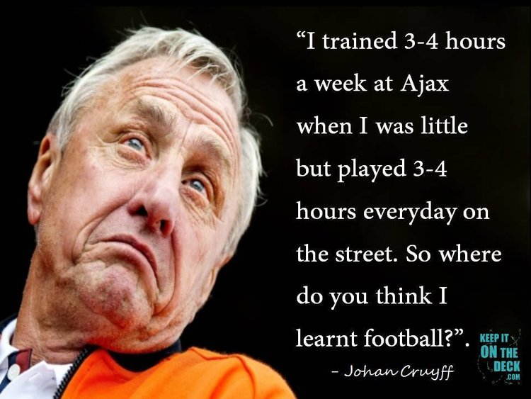
‘’Contact Time’’
Contact time of the average young player from West Limerick is nowhere near that of young players in Dublin and much less again of kids on the continent
Things making it difficult for children to get the required contact time include?
History
Other Sports
Weather
Lack of facilities
Expense
Culture
Lack of knowledge (Coaching)

Slide 25
Hours Per Week?
All over Europe, Aspiring young footballers aged 8-12 train between eight and 12 hours a week while players aged 12-16 can practice as much as 12-15 hours per week at fantastic training facilities
At 16, the best players then enter a full-time football environment at professional clubs
Here at home, our kids get an hour on a Tuesday and Thursday, more often than not on very poor surfaces that might not be fit for a technical football session
Say a child plays u12:
In four years’ time, a player in a Spanish u16 team will have trained for roughly 2,000 more hours than an Irish U16
Is it any wonder Spanish players are better with the ball?

Slide 26
Contact time
• England – 12 hours
• Spain – 14 hours
• Holland – 16 Hours
• Scotland – 18 Hours
• Belgium – 20 hours
• Ireland – 3-8 hours
“The harder I train the luckier I get”
“Genius is one percent inspiration and ninety – nine percent perspiration”

Slide 27
Attendance:
Attendance • Text/Call ASAP – no later than night before
• Sessions pre planned for set numbers
• Excuse must be given
• If injured Attend – Everyday is a school day!
• No excuse/No Text = NOT GOOD!
Be fair to your coaches…

Slide 28
How do we get the most out of our time?
Participation is key in younger years, not discrimination.
Ireland has a specific culture, with so many sports closely woven together like nowhere else and, even if one's preference is badminton, cricket or football, inclusion, rather than exclusion, is vital for the nation's youth.
We have a unique cultural identity which only works here.
Kevin Moran, Niall Quinn, Shane Long etc..
Think outside the box?
Futsal, Work together, Maximize non contact time

Slide 29
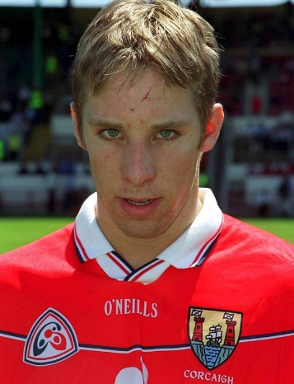
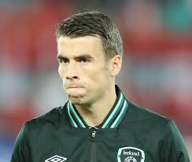
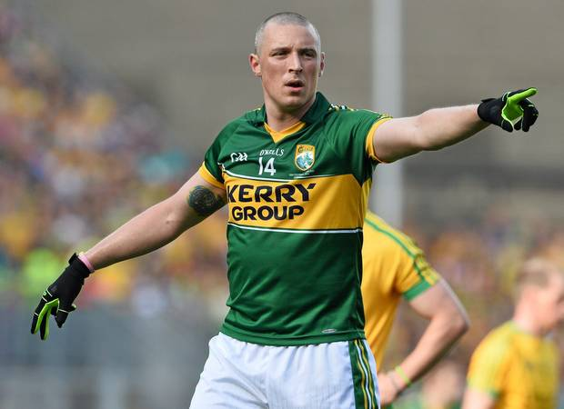
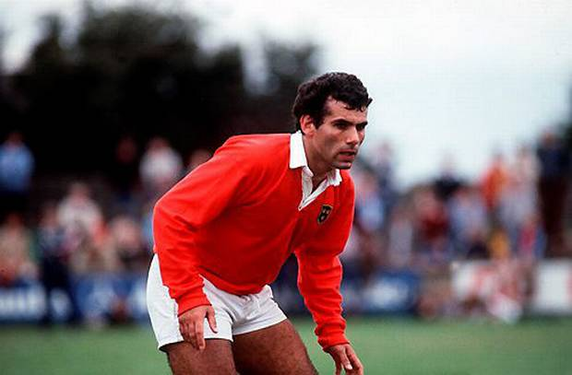
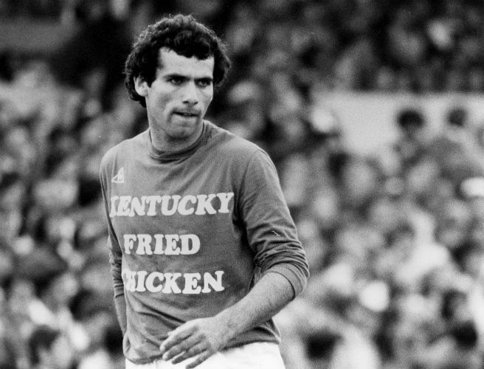
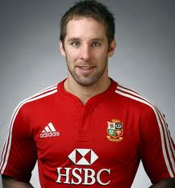
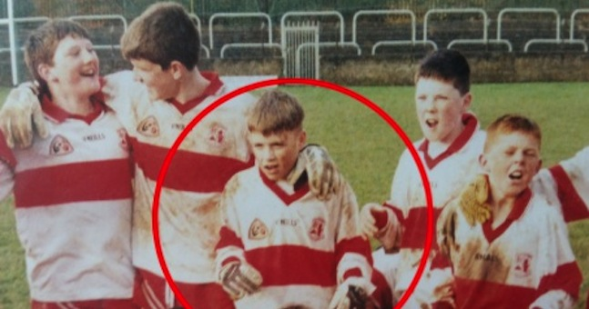
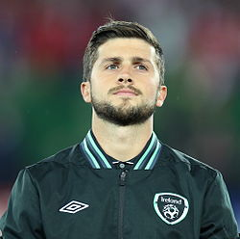
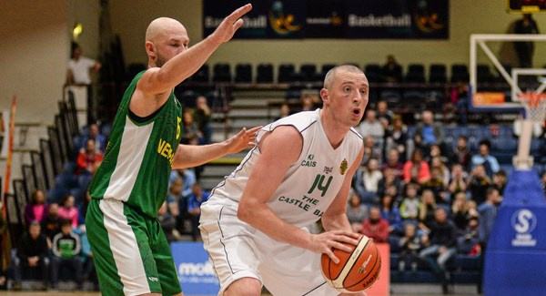
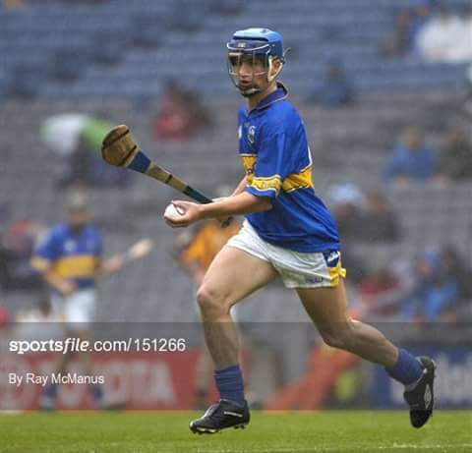

Slide 30
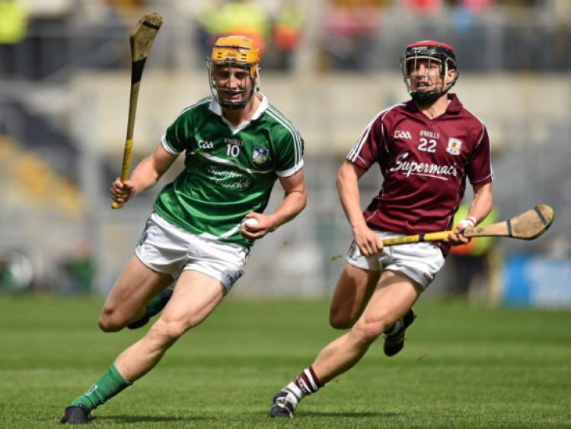
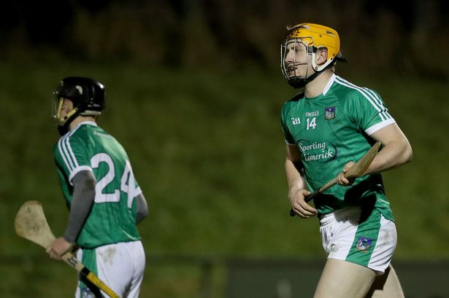
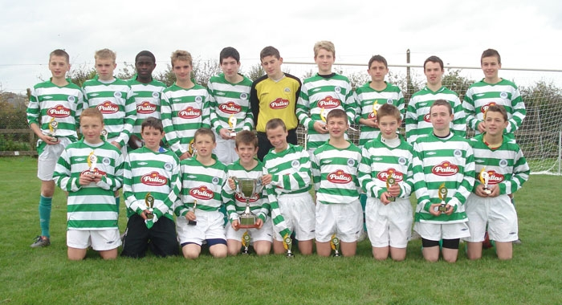

Slide 31
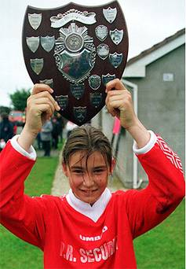
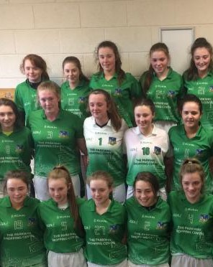
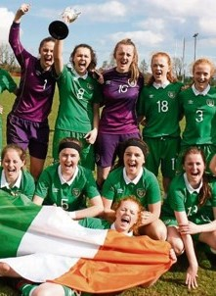
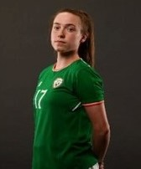
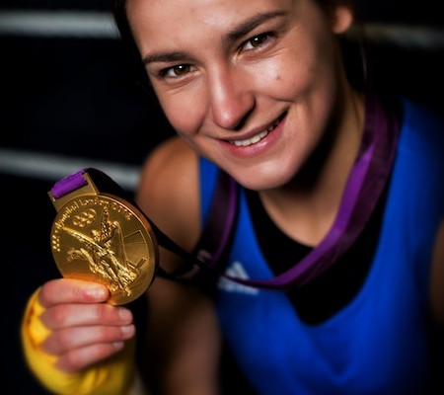
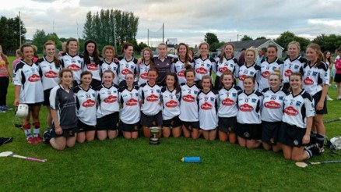

Slide 32
